Slide 1

WalletWatch
Chandler
Stevens
David
Ang
Jason
Djajasasmita
Matthew
Paik

Slide 2

Updated UI

Slide 3
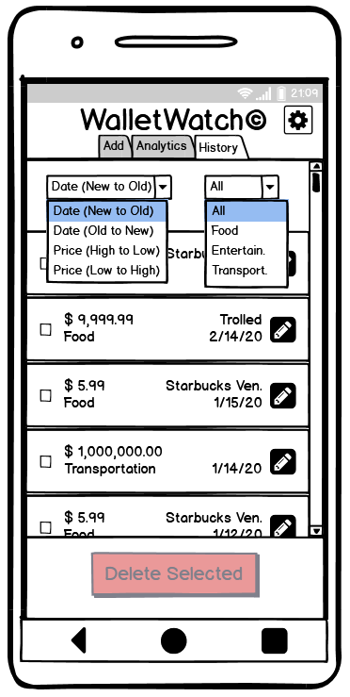
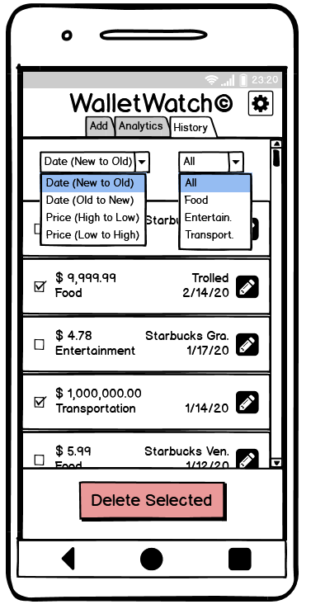
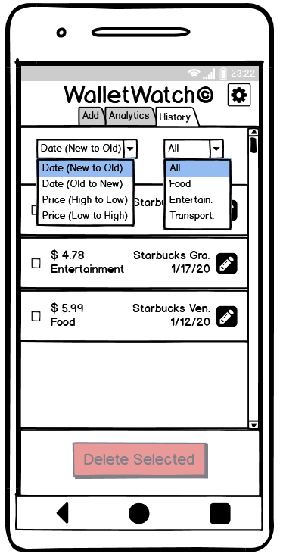
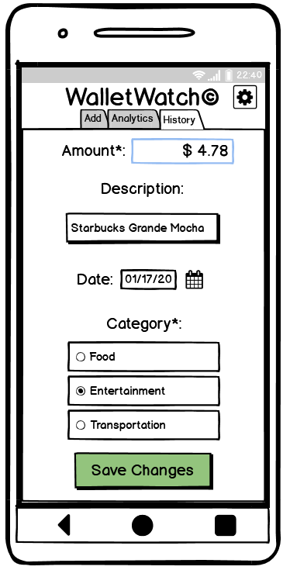
Viewing Expense History

Slide 4
Task List

Slide 5
Task List (Sprints 1-5)
Sprint 1 (3/22-3/28)
Setup Phase
Sprint 2 (3/29-4/4)
Start implementing TAB 1: Add New Entry
Sprint 3 (4/5-4-11)
Finish backlog for TAB 1
Start implementing TAB 2: View Aggregated Analytics
Sprint 4 (4/12-4/18)
Finish creating line chart and totals on UI
Continue implementing TAB 2: View Aggregated Analytics
Sprint 5 (4/19-4/25)
Finish creating pie chart and drop-down selection filters
Continue implementing TAB 2: View Aggregated Analytics

Slide 6
Task List (Sprints 6-10)
Sprint 6 (4/26-5/2)
Finish backlog for TAB 2
Start implementing TAB 3: View Data History
Sprint 7 (5/3-5/9)
Finish creating list and delete functionality
Continue implementing TAB 3: View Data History
Sprint 8 (5/10-5/16)
Finish backlog for TAB 3
Start implementing settings button/window
Sprint 9 (5/17-5/23)
Finish backlog for settings window
Implement PIN verification window
Sprint 10 (5/24-5/30)
Finish backlog for PIN verification
Bug fixes
Finishing Touches
Optionally add extra features

Slide 7
Test Repository

Slide 8
Test Repository
TAB 1 Tests
Ensure screen is always visible upon app launch
Ensure that clicking tab 1 when on a different page will always display tab 1
Ensure all buttons on UI work correctly
Ensure that data stored in XML file is correctly formatted

Slide 9
Test Repository
TAB 2 Tests
Ensure that clicking tab 2 will always display tab 2
Ensure that graphs are accurate
Ensure colors of categories always match total display and graph lines/pie slices
Ensure totals are mathematically correct
Ensure selecting other drop-down options update graph and totals

Slide 10
Test Repository
TAB 3 Tests
Ensure that clicking tab 3 will always display tab 3
Ensure that scrollable list navigates all respective entries
Ensure that all entries display all available expense details
Ensure that deletion works for both single entries and multiple entries
Ensure entry is not changed until user confirms edits
Ensure that upon editing/deleting list of entries that clicking tab 2 will update graph

Slide 11
Test Repository
Settings Tests
Ensure tapping Settings button successfully opens Settings
Ensure that category only changes if user taps Save Changes button and confirms
Ensure that category change completely erases old data
Ensure that category change truly changes category label
Ensure user can toggle PIN off or on
Ensure that PIN only changes once user confirms changed PIN
Ensure that forgotten PIN only displays upon correct answer to security question
Ensure that user can safely exit Settings

Slide 12
Test Repository
PIN Verification Tests
Ensure that PIN verification is only displayed if user opts-in for using a PIN
Ensure that incorrect PIN attempts are rejected
Ensure that correct PIN attempts are accepted
Ensure a correct PIN input proceeds to requested screen

Slide 13
Test Repository
Optional Release Tests
Optionally post app to Google Play Store
Optionally ensure successful download and installation on an Android system

Slide 14
Contact Us
Questions?
Let us know at paikm@spu.edu
Track our progress @ https://github.com/matt2849/CSC4151

